Slide 1
Relationships

Slide 2
Communication

Slide 3
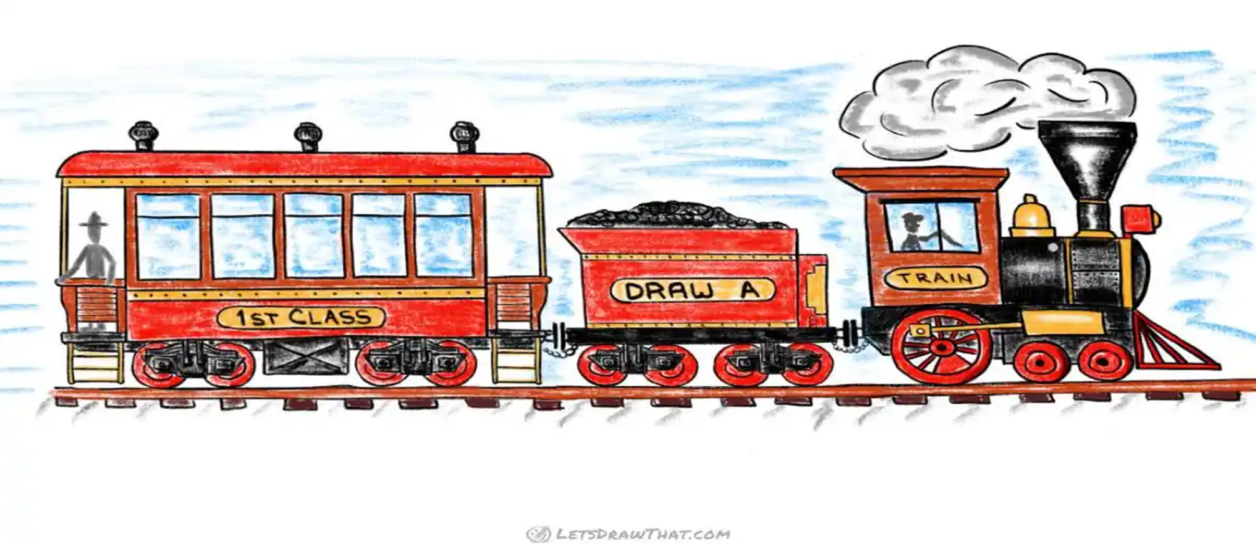

Slide 6

Faith – facts – feelings?

Slide 7
Faith
Facts
Feelings

Slide 8
Feelings
Faith
Facts

Slide 9
Feelings
Facts
Faith

Slide 10
Communication
Face to face
Smoke signals
Pidgeon post
Morse code
Telegraph
Telephone
Radio
TV
Internet
Email
Facebook
Messenger
Texting
Twitter
Instagram
Face to Face

Slide 11
Communication
Face to Face
Talking
Conversation

Slide 12
The Bible as our guide?
Respect
Honour
Truth
Encouraging
Without complaining
Honesty
Love
Bless
psalms, hymns, and songs
Gentle
Confession
Forgiveness
Patient
Slow
Wisdom
Kindness

Slide 13
Psalm 141:3
Set a guard over my mouth, Lord;
keep watch over the door of my lips.

Slide 14
Dominant – Compliant
Lack of self-awareness

Slide 15
The art of communing well…
P
A
C

Slide 16
The art of communing well…
P
Adult
C

Slide 17
The art of communing well…
Parent/teacher
Adult
C

Slide 18
The art of communing well…
Parent/teacher
Adult
Child

Slide 19
The art of communing well…
Adult
Attentive, respectful, listening, gentle, loving, understanding, questioning, reasoned, validating, encouraging, caring, trusting, appreciating, clear, accepting, solution focused

Slide 20
The art of communing well…
Dominant, authoritative, opinionated, corrective, limiting, advising, telling, comparing, criticising, untrusting, judgmental, demanding
Parent
honesty, empathy, self-control, self-reliance, cooperation, cheerfulness, kindness, loving, affectionate, respectful, flexible, empowering, encouraging, patient,

Slide 21
The art of communing well…
Dominant, authoritative, opinionated, corrective, limiting, advising, telling, comparing, criticising, untrusting, judgmental, demanding
Parent

Slide 22
The art of communing well…
Defiant child
Child
Little professor
Wounded child

Slide 23

Defiant Child

Slide 24
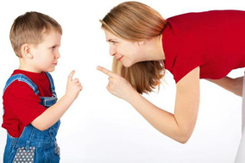
Little professor

Slide 25

Wounded child

Slide 26
The art of communing well…
Parent/teacher
Adult
Child

Slide 27
Women Men
Feeling cared about Feeling understood
Feeling respected
Feeling their partner’s devotion
Feeling validated
Feeling reassured
Feeling trusted (competence)
Feeling accepted
Feeling appreciated
Feeling admired
Feeling approved of
Feeling encouraged

Slide 28
The art of communing well…
Parent/teacher
Adult
Child

Slide 29
The art of communing well…
Adult
Attentive, respectful, listening, gentle, loving, understanding, questioning, reasoned, validating, encouraging, caring, trusting, appreciating, clear, accepting, solution focused

